Slide 1
19CSE202 Database Management Systems Normalization

Slide 2

Overview
Today we’ll discuss
Database Normalization
Data Anomalies Caused by:
Update, Insertion, Deletion
Brief History/Overview
1st Normal Form
2nd Normal Form
3rd Normal Form
Conclusion

Slide 3
The goal of relational database design is to generate a set of relation schemas that allow us to store information without unnecessary redundancy, and to retrieve information efficiently.
We formed relation schemas directly from ER diagram.
How do we know the desirability (good / bad) of a collection of relation schemas?

Slide 4
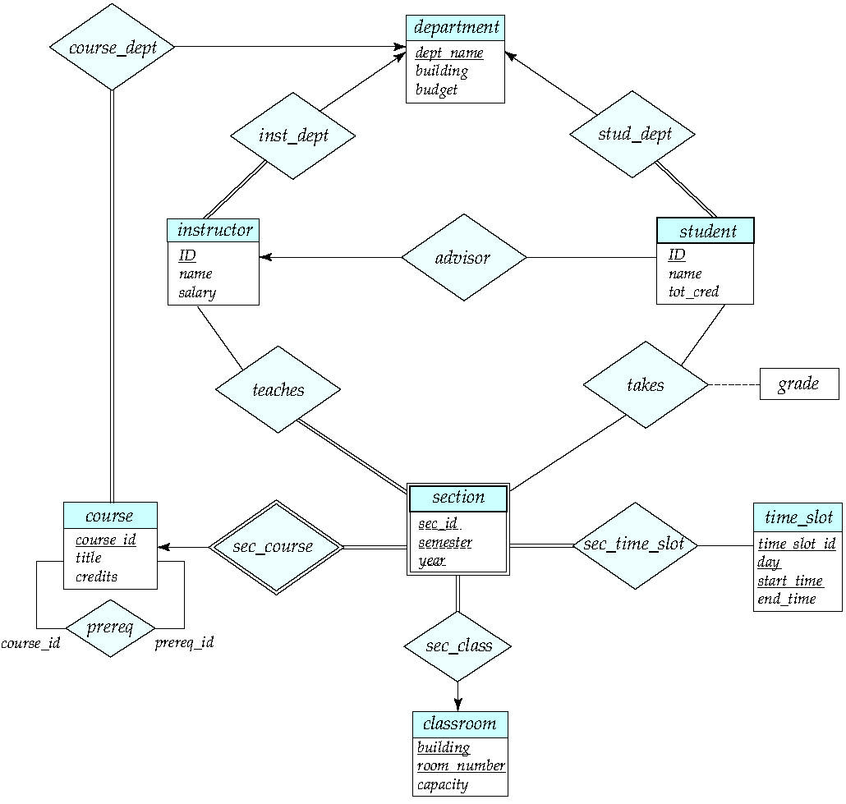
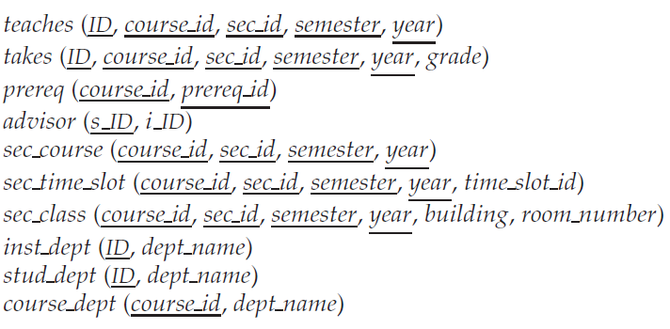

Slide 5
Design alternatives
Large Schema Vs Smaller Schemas
Eg. Instead of instructor (id, name, dept_name, salary) and department (dept_name, builing, budget), if we have
Inst_dept(Id, name, salary, dept_name, building, budget)
It is the result of instructor natural join department.
Drawback
(1) department information is repeated.
- this will lead to inconsistency.
(2) new department can not be added until an instructor joins.

Slide 6
Suppose we started with Large Schema
Inst_dept(Id, name, salary, dept_name, building, budget)
How do we identify the redundancy?
(1) by observing the content
- this is a unreliable process.
- in real-world, the database has a large schema and millions of records.

Slide 7
Suppose we started with Large Schema
Inst_dept(Id, name, salary, dept_name, building, budget)
How do we identify the relation schema to be decomposed?
(1) Database designers to specify rules such as
“each specific value for dept_name corresponds to at most one budge”
In other words we say “If there is a schema (dept_name, budget), the dept_name is able to serve as the primary key”.
This rule is specified as a functional dependency Dept_name → budget
In some schemas, this rule can be checked even if dept_name is not primary key.

Slide 8
Given the rule
Dept_name → budget
Now, we can identify the problem in
Inst_dept(Id, name, salary, dept_name, building, budget)
Here a department may have several records, so the amount of a budget is repeating.
So this schema is to be decomposed as instructor and department.
Finding right decomposition is a tough task. (we have methodologies for that in Normalization).

Slide 9
Not all the decomposition also useful.
Eg. Employee(ID, Name, Street, City, Salary)
Decomposed into
Employee1(ID, Name) and Employee2(Name, Street, City, Salary)
(1234, Kim) (Kim, Raja Street, Coimbatore, 20000)
(2345, Kim) (Kim, V. H. Road, Chennai, 25000)
When we do natural join of Employee 1 and Employee 2
1234, Kim, Raja Street, Coimbatore, 20000
1234, Kim, V. H. Road, Chennai, 25000
2345, Kim, Raja Street, Coimbatore, 20000
2345, Kim, V. H. Road, Chennai, 25000
This decomposition unable to represent Employee – Lossy Decomposition.
Converse of this is lossy decomposition.

Slide 10
Why Database Normalization?
The main goal of Database Normalization is to restructure the logical data model of a database to:
Eliminate redundancy.
Organize data efficiently.
Reduce the potential for data anomalies.

Slide 11
NORMALIZATION
Normalization is formal method to check tables for potential data storage problems termed anomalies.
In order to clarify the discussion, we will formalize the definition of several terms.
KEYS: The term KEY is often confusing because it has different meanings during design and implementation of a system.
DESIGN: During design, KEY means a combination of one or more attributes (columns) of a relational table that uniquely identify rows in the table.
KEY guarantees uniqueness; no two rows can be identical..

Slide 12
NORMALIZATION
IMPLEMENTATION:
During implementation, the term KEY is a column on which the DBMS builds an index or other data structure, to allow quick access to rows.
Such keys need not be unique - they may be secondary keys enabling access to a SET of rows.

Slide 13
Data Anomalies
Data anomalies are inconsistencies in the data stored in a database as a result of an operation such as update, insertion, and/or deletion.
Such inconsistencies may arise when have a particular record stored in multiple locations and not all of the copies are updated.
We can prevent such anomalies by implementing different level of normalization called Normal Forms (NF)

Slide 14
Student
ROLLNO | NAME | BRANCH | HOD | OFFICE_TEL
401 | Asha | CSE | Mr. Sam | 53337
402 | Babu | CSE | Mr. Sam | 53337
403 | Cini | CSE | Mr. Sam | 53337
404 | Dilip | CSE | Mr. Sam | 53337

Slide 15
Employee
EmpId | Name | Dept | Salary | Course | DateTook | Fee
130 | Margaret | Math | 45,000 | Calculus | 01/15 | 150
130 | Margaret | Math | 45,000 | Biology | 02/15 | 200
200 | Susan | Sci | 38,000 | Biology | 01/15 | 200
250 | Chris | Math | 52,000 | Calculus | 03/15 | 150
250 | Chris | Math | 52,000 | Biology | 03/15 | 200
425 | Bill | Math | 48,000 | Algebra | 03/15 | 200
425 | Bill | Math | 48,000 | Calculus | 04/15

Slide 16
Normalisation
Problems With This Table:
Redundancy of data storage.
Potential inconsistencies on updating data.

Slide 17
Data Anomalies
Data Anomalies are problems with data storage caused by poorly structured tables.
Insertion Anomaly
If the primary key is EmpId + Course, to add a new employee, the employee must first be enrolled in a course.
If an employee is not enrolled in a course, then the COURSE column that is part of the composite primary key will be null, and null key values are not allowed.
EmpId | Name | Dept | Salary | Course | DateTook | Fee
130 | Margaret | Math | 45,000 | Calculus | 01/15 | 150
130 | Margaret | Math | 45,000 | Biology | 02/15 | 200
200 | Susan | Sci | 38,000 | Biology | 01/15 | 200
250 | Chris | Math | 52,000 | Calculus | 03/15 | 150
250 | Chris | Math | 52,000 | Biology | 03/15 | 200
425 | Bill | Math | 48,000 | Algebra | 03/15 | 200
425 | Bill | Math | 48,000 | Calculus | 04/15

Slide 18
Data Anomalies
EmpId | Name | Dept | Salary | Course | DateTook | Fee
130 | Margaret | Math | 45,000 | Calculus | 01/15 | 150
130 | Margaret | Math | 45,000 | Biology | 02/15 | 200
200 | Susan | Sci | 38,000 | Biology | 01/15 | 200
250 | Chris | Math | 52,000 | Calculus | 03/15 | 150
250 | Chris | Math | 52,000 | Biology | 03/15 | 200
425 | Bill | Math | 48,000 | Algebra | 03/15 | 200
425 | Bill | Math | 48,000 | Calculus | 04/15
Deletion Anomaly.
Deleting data for Employee #425 (Bill) causes us to lose data about Algebra and the course fee for Algebra because Bill is the only employee who has enrolled in Algebra.
Modification Anomaly.
If the fee for Calculus is increased, the data must be updated for more than one row.

Slide 19
Brief History/Overview
Database Normalization was first proposed by Edgar F. Codd.
Codd defined the first three Normal Forms.
In order to do normalization we must know what the requirements are for each of the three Normal Forms .
One of the key requirements to remember is that Normal Forms are progressive.
That is, in order to have 3rd NF we must have 2nd NF and in order to have 2nd NF we must have 1st NF.

Slide 20
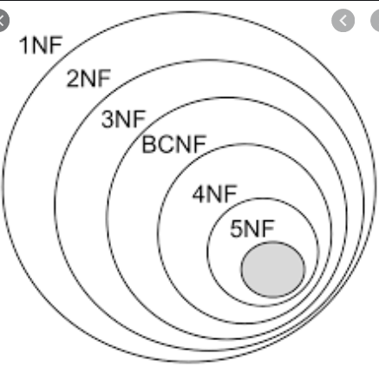
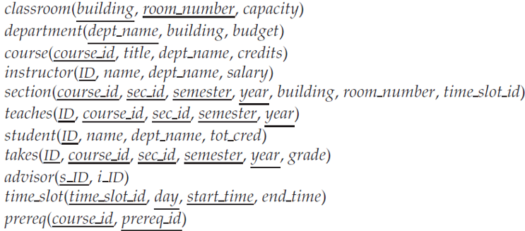
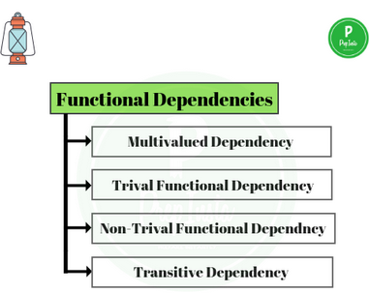
Normalization
Method for designing (refining) relational databases.
Goal: to generate set of relations schemas that allow us to store the data with out redundancy and to retrieve the data easily.
Approach: to design the schemas that are in normal form. (Rule)
To check the normal form we need additional information, such as functional dependency. (Conditions)

Slide 21
First Normal Form (1NF)-The Requirements
The requirements to satisfy the First Normal Form (1NF):
Each table has a primary key: minimal set of attributes which can uniquely identify a record
The values in each column of a table are atomic (No multi-valued attributes allowed).
There are no repeating groups: two columns do not store similar information in the same table.

Slide 22
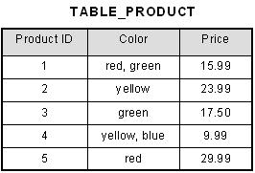
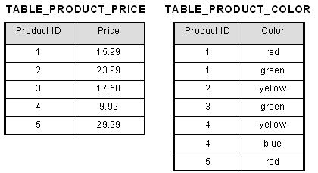
First Normal Form - No multivalued attributes
A domain is atomic if elements of the domain are indivisible.
We say that a relation schema R is in first normal form (1NF) if the domains of all attributes of R are atomic.

Slide 23
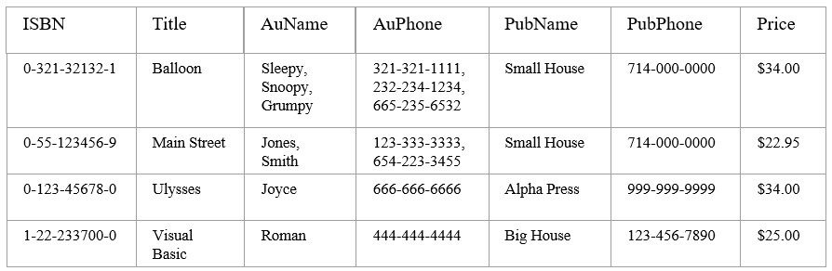
A table is considered to be in 1NF if all the fields contain
only scalar values (as opposed to list of values).
Example (Not 1NF)
Author and AuPhone columns are not scalar
Notes:
Having scalar values also means that all instances of a record type must contain the same number of fields.
A table not in first normal form is called un normalized

Slide 24
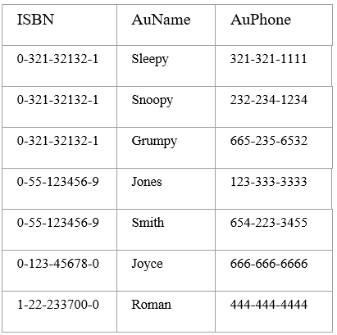
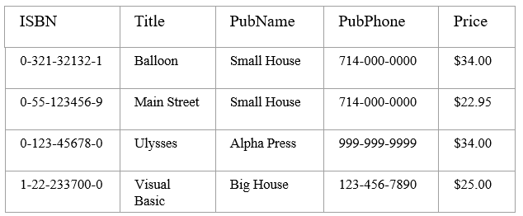
1NF - Decomposition
Place all items that appear in the repeating group in a new table
Designate a primary key for each new table produced.
Duplicate in the new table the primary key of the table from which the repeating group was extracted or vice versa.
Example (1NF)
Notes:
1. The designated key will be the primary key of the original table concatenated with one or more data items from the new table.
For the first table the primary key is ISBN
For the second table the primary key is ISBN + Author Name

Slide 25
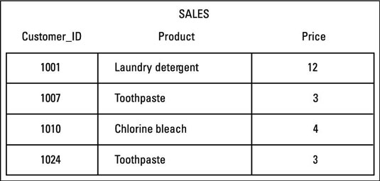
Is it in First normal form (1 NF)?

Slide 26
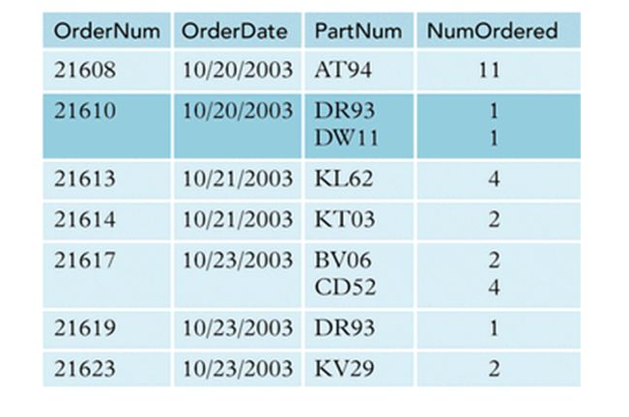
Is it in First normal form (1 NF)?

Slide 27
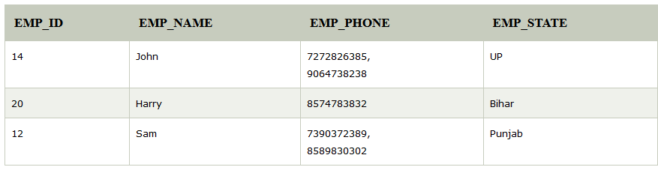
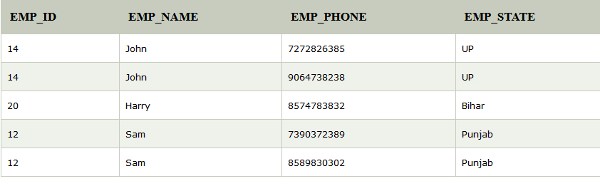
Not in 1 NF
In 1 NF

Slide 28
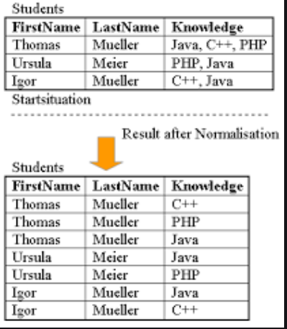

Slide 29
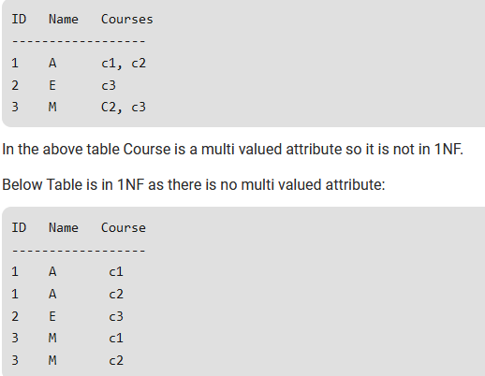

Slide 30
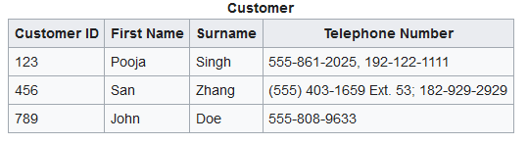
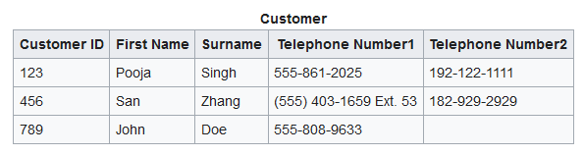

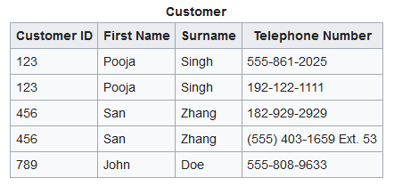
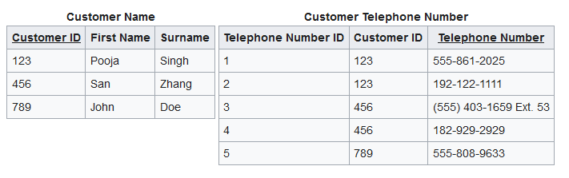
There are no repeating groups: two columns do not store similar information in the same table.
This violates first normal form.
An apparent solution is to introduce more columns:
The two telephone number columns still form a "repeating group":
Adding an extra telephone number may require the table to be reorganized by the addition of a new column.
And we ensure no row contains more than one phone number

Slide 31
First Normal Form(1NF) - Example
Un-normalized Students table:
Student# | AdvID | AdvName | AdvRoom | Class1 | Class2
123 | 123A | James | 555 | 102-8 | 104-9
124 | 123B | Smith | 467 | 209-0 | 102-8
Normalized Students table:
Student Table
Student# | AdvID | AdvName | AdvRoom
123 | 123A | James | 555
124 | 123B | Smith | 467
Student# | AdvID | AdvName | AdvRoom | Class#
123 | 123A | James | 555 | 102-8
123 | 123A | James | 555 | 104-9
124 | 123B | Smith | 467 | 209-0
124 | 123B | Smith | 467 | 102-8
Student# | Class#
123 | 102-8
123 | 104-9
124 | 209-0
124 | 102-8

Slide 32
Functional Dependency
Eg.
Each specific value of dept_name corresponds to at most one budget.
In other words “if there were a schema (dept_name, budget), the dept_name is able to serve as the primary key”
This is rule is specified as a functional dependency
dept_name → budget
In X→Y, X functionally determines Y. The left-hand side attributes determine the values of attributes on the right-hand side.

Slide 33
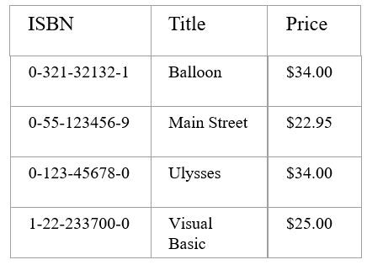
Functional Dependencies
If one set of attributes in a table determines another set of attributes in the table, then the second set of attributes is said to be functionally dependent on the first set of attributes.
Example 1
Table Scheme: {ISBN, Title, Price}
Functional Dependencies:
{ISBN} → {Title}
{ISBN} → {Price}
Notes:
Notes to Instructor: Need more rigor in the functional dependencies. With a few examples. May be create a class assignment for functional dependencies.

Slide 34
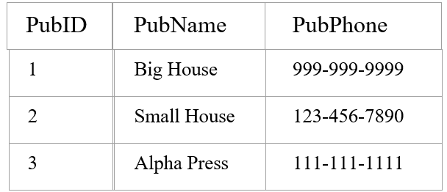
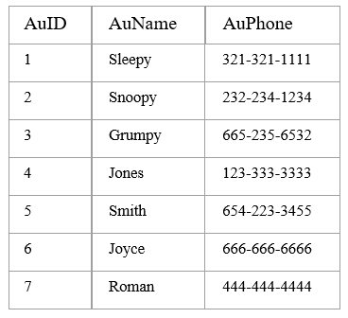
Functional Dependencies
Example 2
Table Scheme: {PubID, PubName, PubPhone}
Functional Dependencies:
{PubId} → {PubPhone}
{PubId} → {PubName}
{PubName, PubPhone} → {PubID}
Example 3
Table Scheme: {AuID, AuName, AuPhone}
Functional Dependencies:
{AuId} → {AuPhone}
{AuId} → {AuName}
{AuName, AuPhone} → {AuID}

Slide 35
Functional Dependency Vs Superkey
Super key is a set of attributes that uniquely identifies an entire tuple.
if K is a superkey of r(R), then K → R
A functional dependency allows us to express constraints that uniquely identify values of certain attributes.
In a relation A→ B means, for any two tuples t1 and t2 if t1[A]=t2[A] then t1[B]= t2[B].

Slide 36
Trivial functional dependency
The fds which are satisfied by all relations.
Example.
A→ A
AB→ A (ie, in X → Y if Y is a subset of X)
Given a set of fds holds on a relation r(R) it is possible to infer certain other fds, which is denoted as F⁺ (F Closure)

Slide 37
2NF - 1 NF plus no partial dependencies
a table is in 2NF if and only if it is in 1NF and no non-prime attribute is dependent on any proper subset of any candidate key of the table.
A non-prime attribute of a table is an attribute that is not a part of any candidate key of the table.

Slide 38
Second Normal Form (2NF)
For a table to be in 2NF, there are two requirements
The database is in first normal form
All non-key attributes in the table must be functionally dependent on the entire primary key
Note: Remember that we are dealing with non-key attributes
Example 1 (Not 2NF)
Schema→ {Title, PubId, AuId, Price, AuAddress}
Key → {Title, PubId, AuId}
{Title, PubId, AuID} → {Price}
{AuID} → {AuAddress}
AuAddress does not belong to a key
AuAddress functionally depends on AuId which is a subset of a key

Slide 39
Second Normal Form (2NF)
Example 2 (Not 2NF)
Schema → {City, Street, HouseNumber, HouseColor, CityPopulation}
key → {City, Street, HouseNumber}
{City, Street, HouseNumber} → {HouseColor}
{City} → {CityPopulation}
CityPopulation does not belong to any key.
CityPopulation is functionally dependent on the City which is a proper subset of the key
Example 3 (Not 2NF)
Schema → {studio, movie, budget, studio_city}
Key → {studio, movie}
{studio, movie} → {budget}
{studio} → {studio_city}
studio_city is not a part of a key
studio_city functionally depends on studio which is a proper subset of the key
Notes:
Let us consider the problems with the movie studio database:
Redundancy – City Population is repeated many times
Insertion anomaly – Whenever we add a new record we have to add unnecessary information. We can not add record until we know information about the city population
Deletion anomaly – Whenever we delete a record, useful information is deleted.
Update anomaly – The City Population needs to be updated in more than one location if it changes.

Slide 40
2NF - Decomposition
If a data item is fully functionally dependent on only a part of the primary key, move that data item and that part of the primary key to a new table.
If there are other data items which are functionally dependent on the same part of the key, place them also in the new table.
Make the partial primary key copied from the original table as the primary key for the new table. Place all items that appear in the repeating group in a new table
Example 1 (Convert to 2NF)
Old Schema → {Title, PubId, AuId, Price, AuAddress}
New Schema → {Title, PubId, AuId, Price}
New Schema → {AuId, AuAddress}
Notes:
If there is a table with columns A,B,C,D with Primary Key (A,B) & D is dependant on A (alone) then to be 2NF, you should reduce (split) tables as:
Table with columns A,D with Primary Key (A)
Table with columns A,B,C with Primary Key (A,B)

Slide 41
2NF - Decomposition
Example 2 (Convert to 2NF)
Old Schema → {Studio, Movie, Budget, StudioCity}
New Schema → {Movie, Studio, Budget}
New Schema → {Studio, StudioCity}
Example 3 (Convert to 2NF)
Old Schema → {City, Street, HouseNumber, HouseColor, CityPopulation}
New Schema → {City, Street, HouseNumber, HouseColor}
New Schema → {City, CityPopulation}

Slide 42
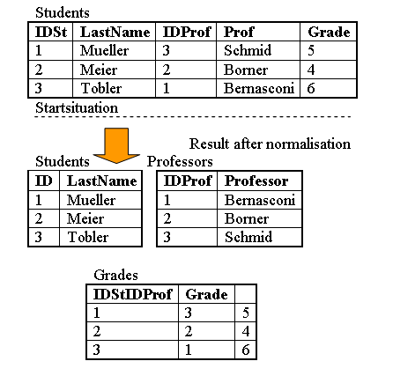
Second normal form:
A relation is in second normal form if it is in 1NF and every non key attribute is fully functionally dependent on the primary key.
A university uses the following relation: Student(IDSt, StudentName, IDProf, ProfessorName, Grade)
Key(Idst,IDProf) The attributes IDSt and IDProf are the identification keys. All attributes are single valued (1NF). The following functional dependencies exist: 1. The attribute ProfessorName is functionally dependent on
attribute IDProf
(IDProf --> ProfessorName) 2. The attribute StudentName is functionally dependent
on IDSt
(IDSt --> StudentName) 3. The attribute Grade is fully functional dependent on IDSt and IDProf
(IDSt, IDProf --> Grade)
The table in this example is in first normal form (1NF) since all attributes are single valued. But it is not yet in 2NF. If student 1 leaves university and the tuple is deleted, then we loose all information about professor Schmid, since this attribute is fully functional dependent on the primary key IDSt.

Slide 43
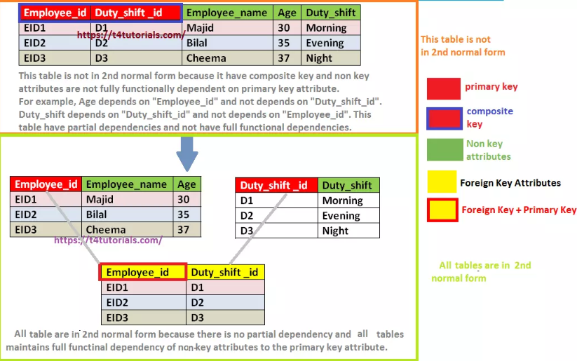

Slide 44
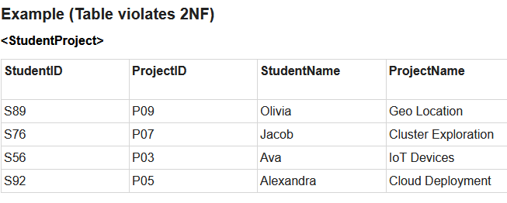
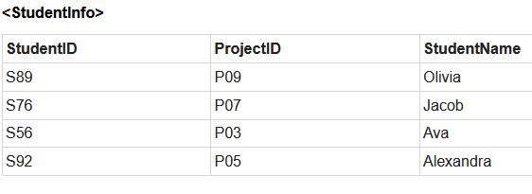
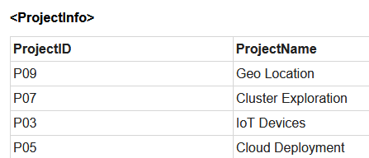
A table is in 2NF, only if a relation is in 1NF and meet all the rules, and every non-key attribute is fully dependent on primary key.
The Second Normal Form eliminates partial dependencies on primary keys.
Let us see an example −
In the given table, we have partial dependency; let us see how −
The prime key attributes are StudentID and ProjectID.
As stated, the non-prime attributes i.e. StudentName and ProjectName should be functionally dependent on part of a candidate key, to be Partial Dependent.
The StudentName can be determined by StudentID, which makes the relation Partial Dependent.
The ProjectName can be determined by ProjectID, which makes the relation Partial Dependent.
Therefore, the <StudentProject> relation violates the 2NF in Normalization and is considered a bad database design.

Slide 45
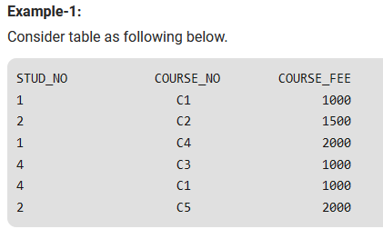
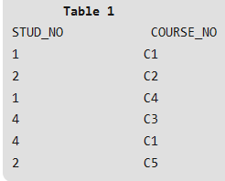

COURSE_FEE cannot alone decide the value of COURSE_NO or STUD_NO;
COURSE_FEE together with STUD_NO cannot decide the value of COURSE_NO;
COURSE_FEE together with COURSE_NO cannot decide the value of STUD_NO;
Hence, COURSE_FEE would be a non-prime attribute, as it does not belong to the one only candidate key {STUD_NO, COURSE_NO} ;
But, COURSE_NO -> COURSE_FEE, i.e., COURSE_FEE is dependent on COURSE_NO, which is a proper subset of the candidate key. Non-prime attribute COURSE_FEE is dependent on a proper subset of the candidate key, which is a partial dependency and so this relation is not in 2NF.

Slide 46

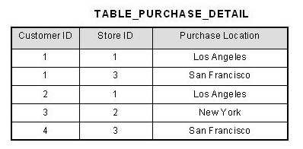
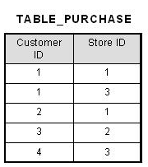
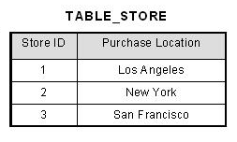
This table has a composite primary key [Customer ID, Store ID]. The non-key attribute is [Purchase Location].
In this case, [Purchase Location] only depends on [Store ID], which is only part of the primary key. Therefore, this table does not satisfy second normal form.
To bring this table to second normal form, we break the table into two tables, and now we have the following:

Slide 47
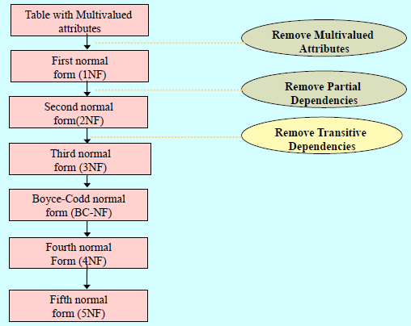
3 NF

Slide 48
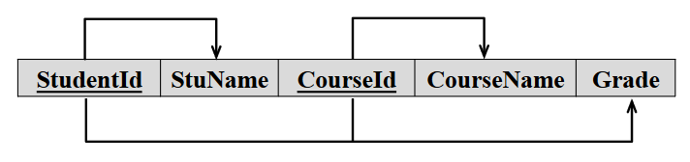
What do you understand from the diagram below?

Slide 49
Is there any partial FD?

Slide 50
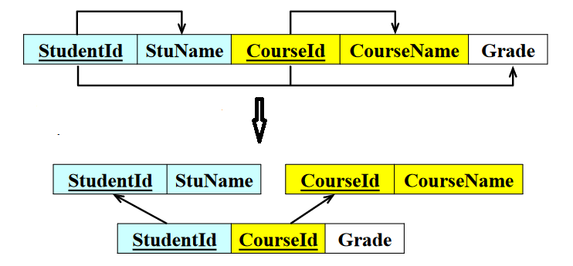
Which normal form is carried out?

Slide 51
Third Normal Form
2NF and no transitive dependencies
• A transitive dependency is when a non-key attribute depends on another non-key attribute.
If A->B and B->C are two FDs then A->C is called transitive dependency.
(If A is prime, B and C are non-prime)
• Note: This is called transitive, because the primary key is a determinant for another attribute, which in turn is a determinant for a third attribute.

Slide 52
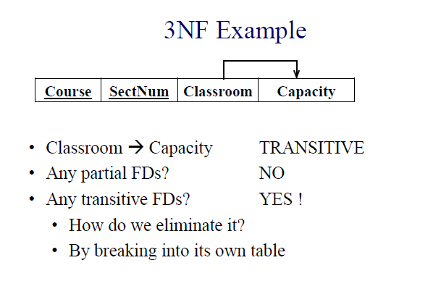
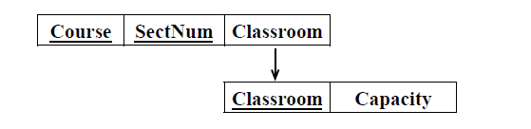

Slide 53
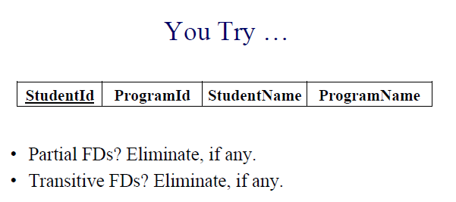

Slide 54
FDs
StudentID → StudentName
StudentID → ProgramId
StudentID → ProgramName
ProgramID→ ProgramName
Partial FDs – No.
Full FDs
StudentID → StudentName
StudentID → ProgramId
StudentID → ProgramName
Transitive FDs
ProgramID→ ProgramName
(StudentID, ProgramId, StudentName)
(ProgramID, ProgramName)

Slide 55
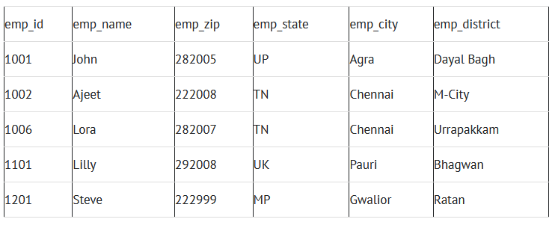
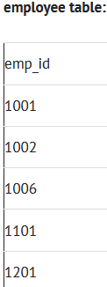
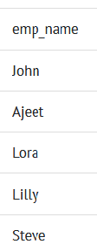
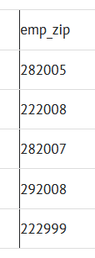
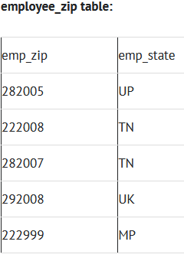
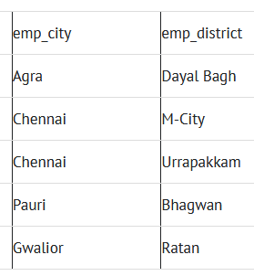
A table design is said to be in 3NF if both the following conditions hold:
Table must be in 2NF
Transitive functional dependency of non-prime attribute on any super key should be removed.
Super keys: {emp_id}, {emp_id, emp_name}, {emp_id, emp_name, emp_zip}…so on Candidate Keys: {emp_id} Non-prime attributes: all attributes except emp_id are non-prime as they are not part of any candidate keys.
Here, emp_state, emp_city & emp_district dependent on emp_zip.
And, emp_zip is dependent on emp_id that makes non-prime attributes (emp_state, emp_city & emp_district) transitively dependent on super key (emp_id). This violates the rule of 3NF.
emp_zip→emp_state, empt_City, emp_district
emp_id→emp_zip

Slide 56

Third Normal Form (3NF)
A relation is in third normal form, if there is no transitive dependency for non-prime attributes as well as it is in second normal form.
FD set: {STUD_NO -> STUD_NAME,
STUD_NO -> STUD_STATE,
STUD_STATE -> STUD_COUNTRY,
STUD_NO -> STUD_AGE}
Candidate Key: {STUD_NO}
decompose the relation
STUDENT (STUD_NO, STUD_NAME, STUD_STATE, STUD_COUNTRY_STUD_AGE) as:
STUDENT(STUD_NO, STUD_NAME, STUDS_STATE, STUD_AGE)
And STATE_COUNTRY (STATE, COUNTRY)

Slide 57
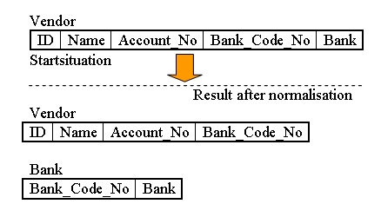
The following dependencies exist: 1. Name, Account_No, Bank_Code_No are functionally dependent on ID
(ID --> Name, Account_No Bank_Code_No) 2. Bank is functionally dependent on Bank_Code_No
(Bank_Code_No --> Bank)

Slide 58
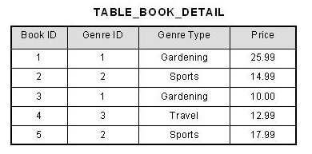
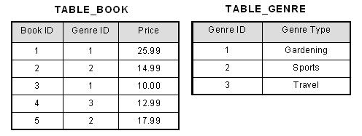
In the table able, [Book ID] determines [Genre ID], and [Genre ID] determines [Genre Type]. Therefore, [Book ID] determines [Genre Type] via [Genre ID] and we have transitive functional dependency, and this structure does not satisfy third normal form.
To bring this table to third normal form, we split the table into two as follows:

Slide 59
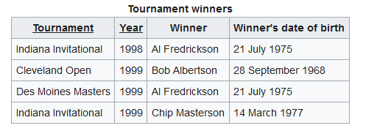
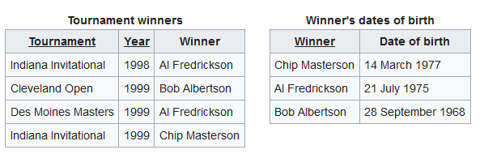

Slide 60

You Try…
Is it in 3NF?

Slide 61


You Try…
Not in 3NF
Cust_id → zip
zip → Street, City, State
The advantages of removing transitive dependencies
the amount of data duplication is reduced and therefore your database becomes smaller.
When duplicated data changes, there is a big risk of updating only some of the data, especially if it is spread out in many different places in the database.

Slide 62


Slide 63


Slide 64


Slide 65


Slide 66
Conclusion
We have seen how
Database Normalization can
Decrease redundancy
Increase efficiency and
Reduce anomalies
by implementing three of different levels of normalization called Normal Forms.
The first three Normal Forms are usually sufficient for most small to medium size applications.

Slide 67
References
Hillyer Mike, MySQL AB. An Introduction to Database Normalization, http://dev.mysql.com/tech-resources/articles/intro-to-normalization.html, accessed October 17, 2006.
Microsoft. Description of the database normalization basics, http://support.microsoft.com/kb/283878 , accessed October 17, 2006.
Wikipedia. Database Normalization. http://en.wikipedia.org/wiki/Database_normalization.html , accessed October 17, 2006.
https://www.db-book.com/db6/index.html
https://www.youtube.com/watch?v=mfVCesoMaGA&list=PLroEs25KGvwzmvIxYHRhoGTz9w8LeXek0&index=22

Slide 68
Thank You
Happy to answer any questions ! ! !
Notes:
Not covering all.

